Slide 1
Pan Evaporation Rates of Southeastern Arizona
Alison Radei
Mentors: Dr. Mary Nichols and Michelle Cavanaugh
USDA-ARS-Southwest Watershed Research Center
April 12, 2014

Slide 2
Background
Evaporation is a critical component of the hydrologic cycle
Evaporation data are needed for:
estimating transpiration from plants
computing losses from ponds and lakes
credit: http://www.state.nj.us/drbc/hydrological/

Slide 3
Background
Although global temperatures have been increasing, decreasing rates of pan evaporation have been reported in the literature.
Decreasing pan evaporation rates have been attributed to changes in wind patterns

Slide 4
Objectives
Quantify pan evaporation rates from data collected in Tombstone, Arizona.
Determine if there are trends over time in monthly evaporation rates.

Slide 5
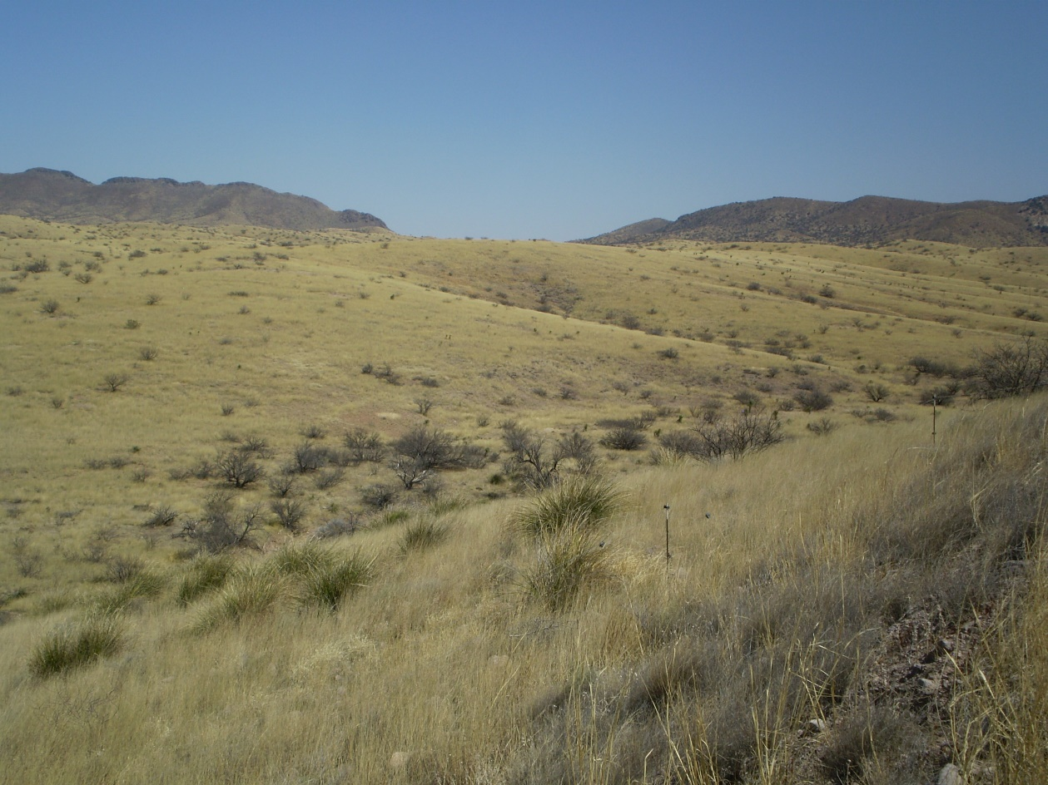
Study Area
USDA-ARS
Walnut Gulch Experimental Watershed Tombstone Arizona
Semiarid
Rangeland

Slide 6
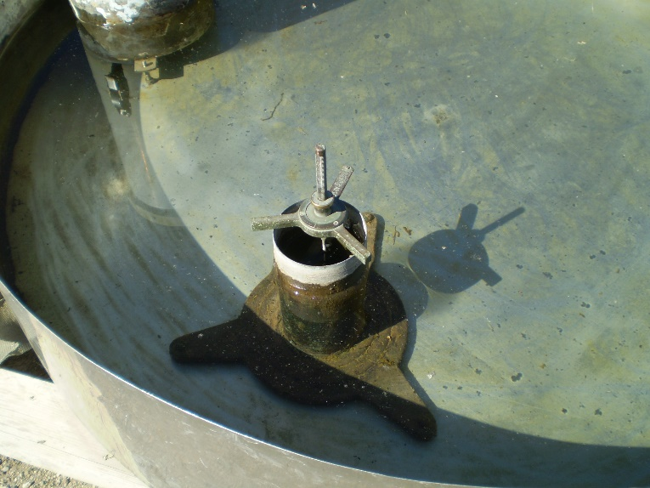
Methods
Class A evaporation pan
A hook gage is used to measure water depth
Measurements are recorded daily at 8 a.m.
Data collected from 1974 to 2012 were used in this study

Slide 7
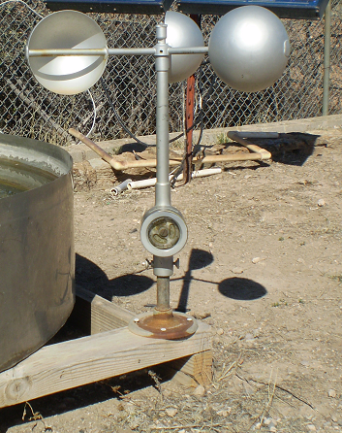
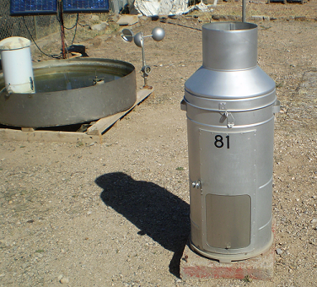
Methods
Additional measurements:
daily maximum & minimum temperature
8 a.m. temperature
wind speed
precipitation
Raingage
Anemometer

Slide 8
Data
39 years of data were entered into a spreadsheet
Data were evaluated to identify outliers and gaps in the record
Poor quality measurements were identified
e.g. ice in the pan
Daily data were combined to estimate monthly pan evaporation values

Slide 9
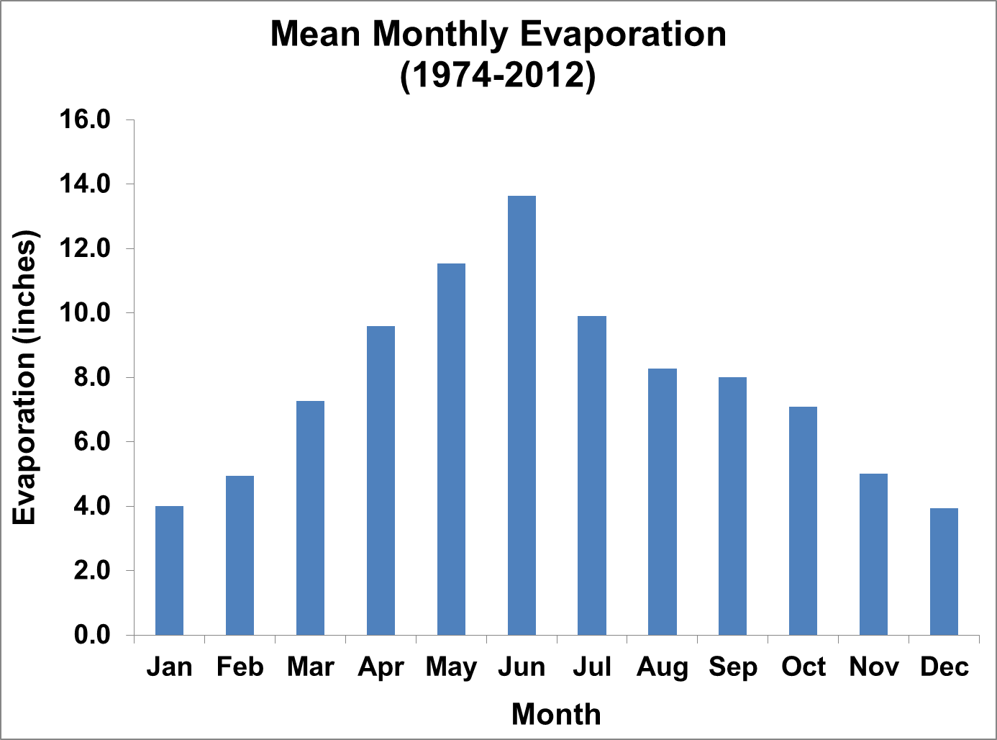
Preliminary Results
Mean monthly evaporation ranged from a minimum of 4 inches per month in January to a maximum of 13 inches per month in June.
We then plotted annual evaporation for individual months.

Slide 10
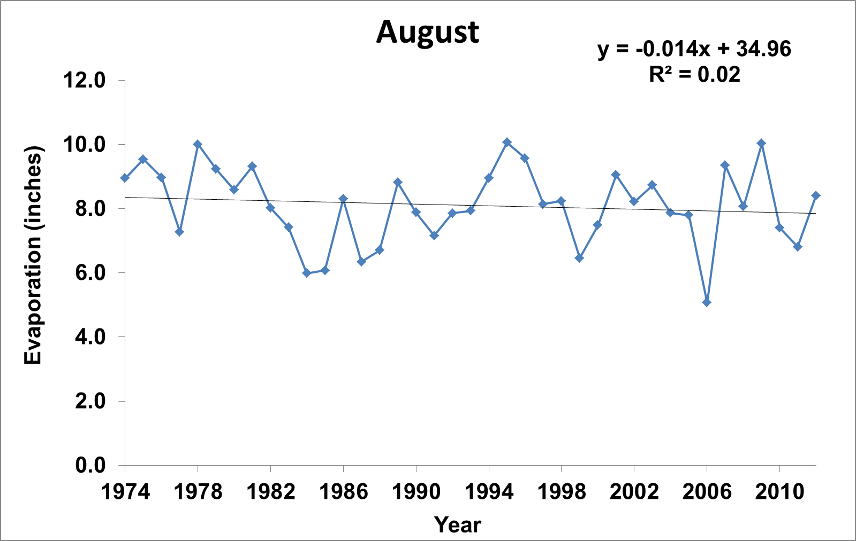
Preliminary Results
Annual evaporation rates for each month were plotted over the 39 year period of record
Preliminary analysis to look for trends in time

Slide 11
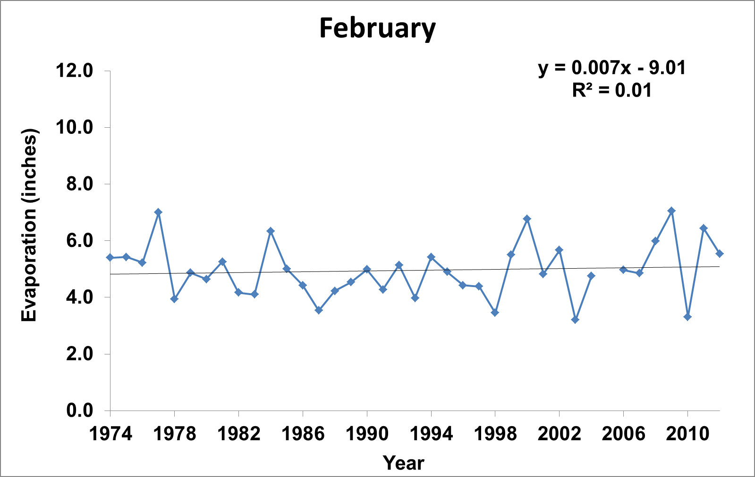
Preliminary Results
Annual pan evaporation rates are variable, but do not show strong trends with time

Slide 12
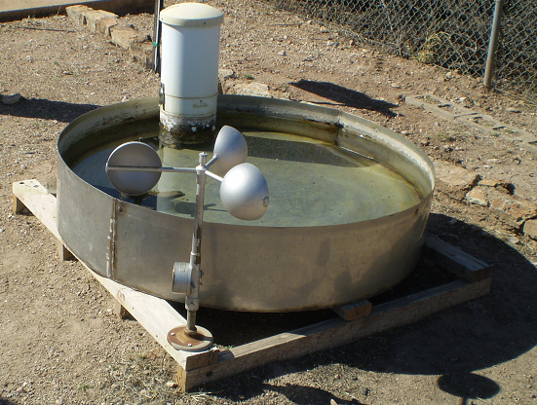
Conclusions
Long-term mean monthly pan evaporation rates at Tombstone, Arizona range from 4 inches per month to 13 inches per month. These values are consistent with other pan evaporation rates in Southeastern Arizona.
Preliminary results do not suggest strong trends in pan evaporation over the 39 year period of record.
Research to interpret these data is ongoing.
Future research will relate pan evaporation rates to wind speed, humidity, and temperature.

Slide 13
Thank You

